Slide 1
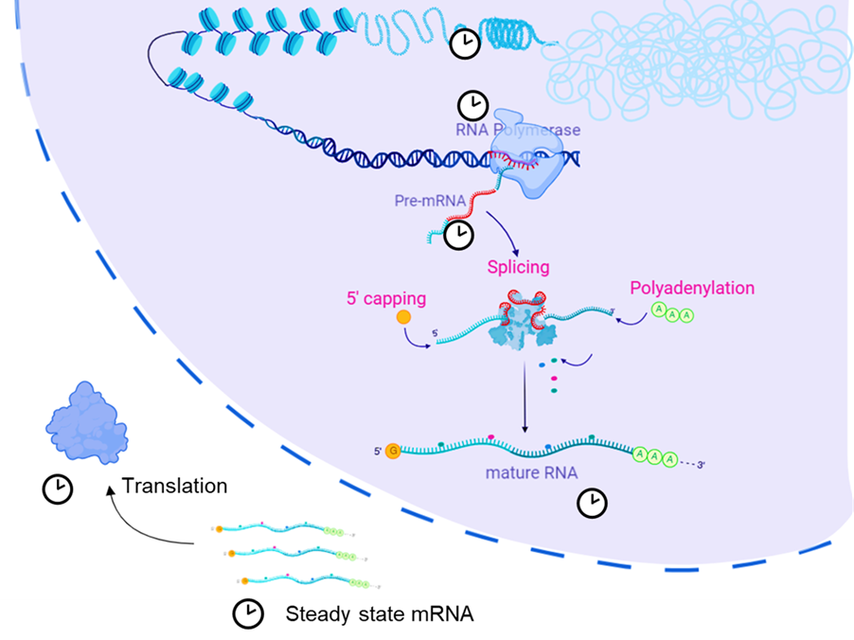
Alternative Splicing
DNA
Exon1
Exon2
Exon3
Exon4
Intron1
Intron2
Intron3
Pre-mRNA
Exon1
Exon2
Exon3
Exon4
mRNA
Isoform 1
Isoform 2
Isoform 3

Slide 2
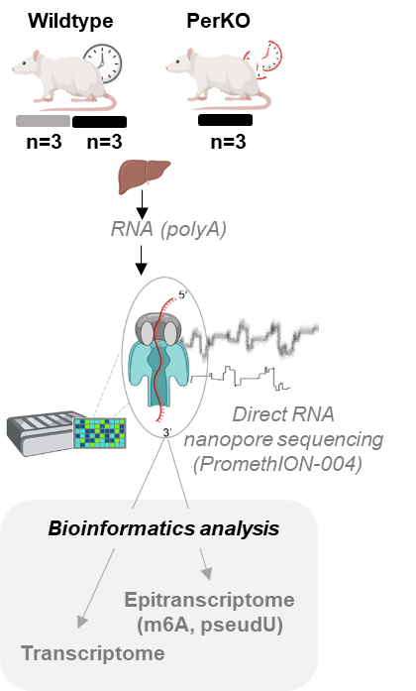
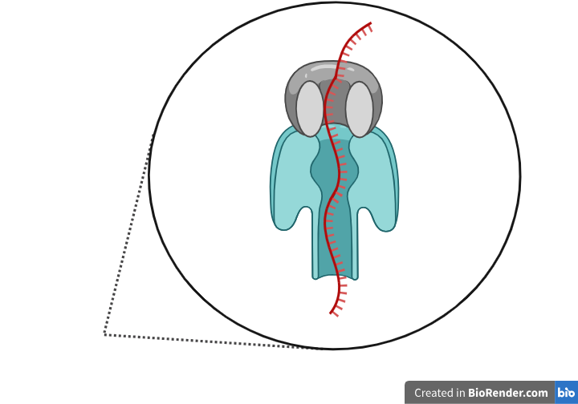

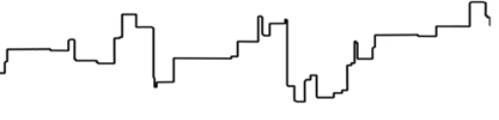
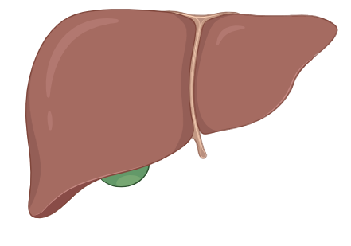
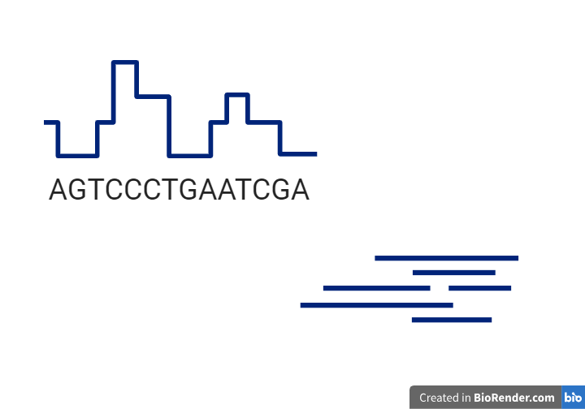
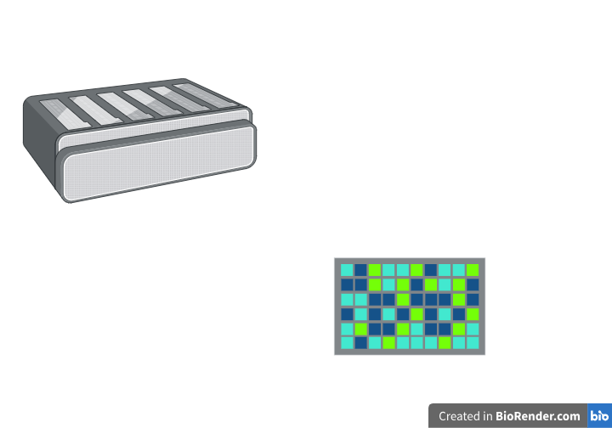
Experimental design
5’
Sequencing
Here do my informatics pipeline
Base-calling
3’
CGTTGATTTGCTGGGGG
RNA (liver)
Reads
Mouse Reference Genome
Alignment
Nanopore RNA sequencing
Downstream analyses
Bioinformatics analysis

Slide 3
Experimental design of Project 2
5’
Sequencing
Base-calling
3’
CGTTGATTTGCTGGGGG
RNA (polyA)
Reads
Reference
Alignment
Direct RNA nanopore sequencing
Downstream analyses
Transcriptome
Alternative Splicing

